Slide 1
Weekly Project Update
Laurent Bialylew
Jalal Mammadov

Slide 2
Work done this week
01
02
03
Created UMLs
Added new UML diagrams
Created new classes
Created vehicle, road, and junction classes
Created new functions
Created functions for adding and viewing vehicle, road, and junction list

Slide 3
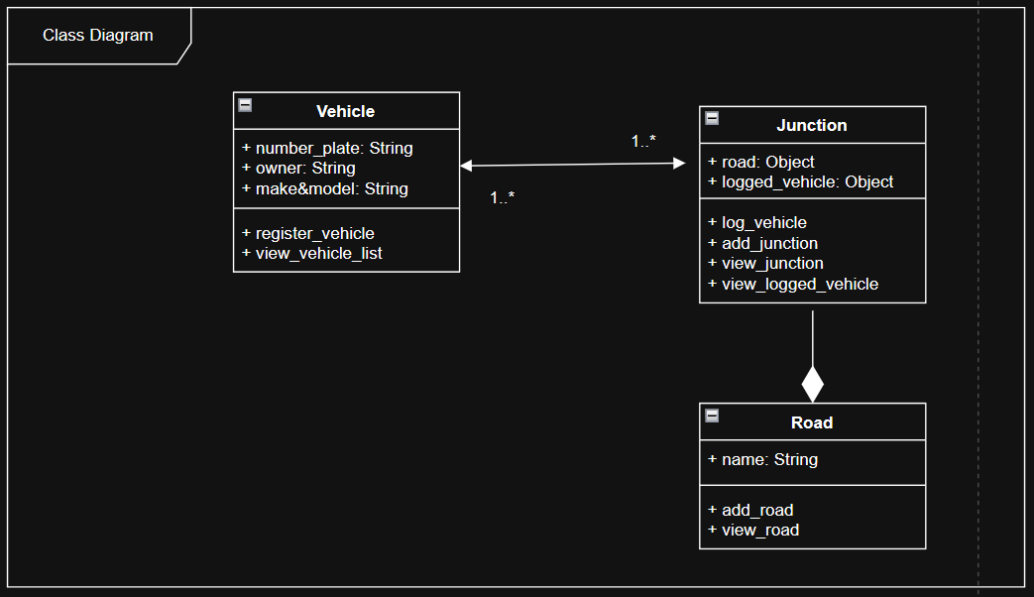
Class Diagram

Slide 4
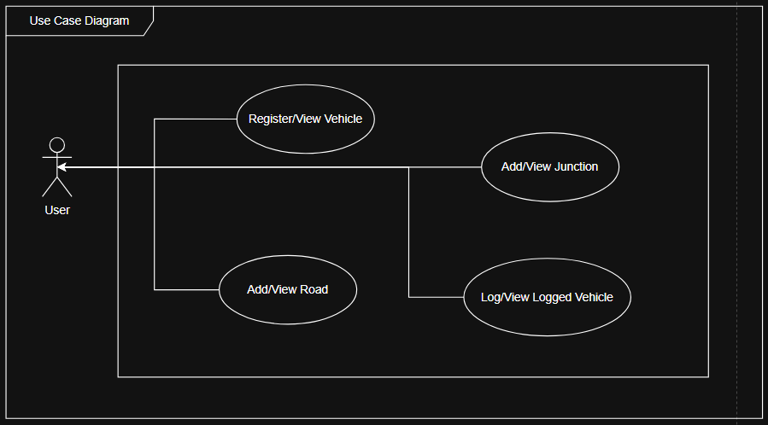
Use Case Diagram

Slide 5
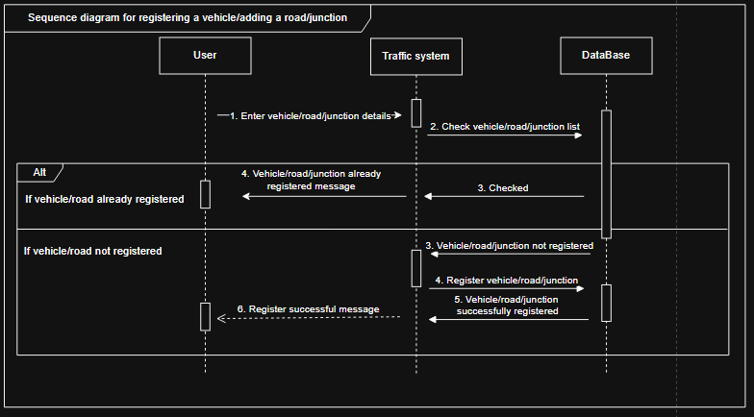
Sequence Diagram registering and adding vehicles/roads/junctions

Slide 6
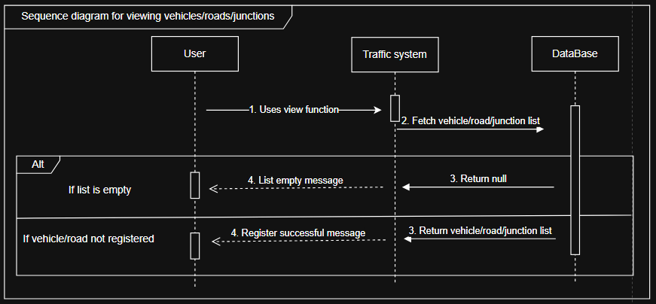
Sequence Diagram for viewing list of vehicle/road/junction

Slide 7
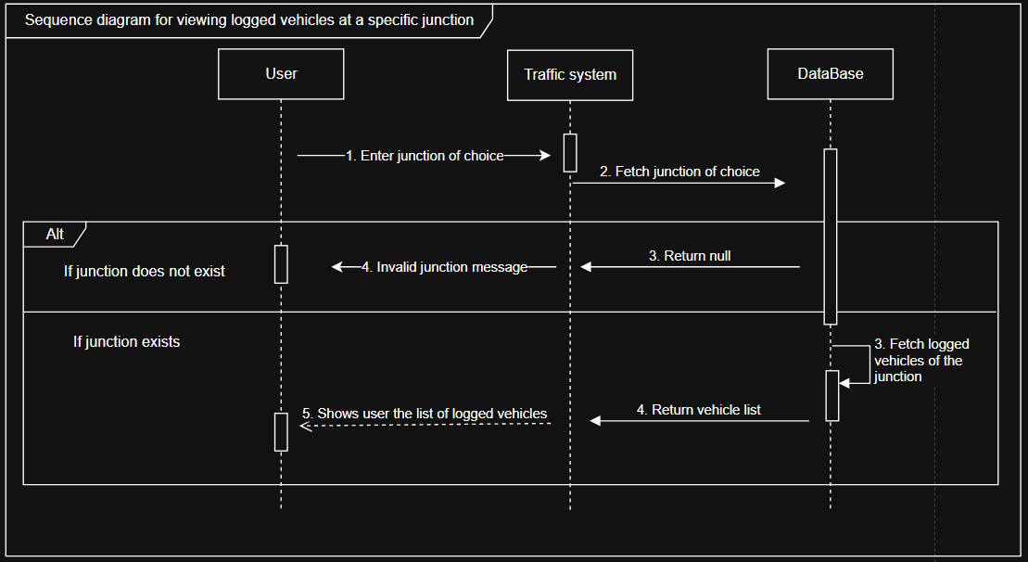
Sequence Diagram for viewing logged vehicles at a specific junctions

